Slide 1
Syllabus: Inorganic
VSEPR,
Valence bond theory,
Molecular orbital theory,
Coordination chemistry and colour of complex, Crystal field theory
Ligand field theory.

Slide 2
VSEPR
The Valence Shell Electron Pair Repulsion Theory abbreviated as VSEPR theory is based on the premise that there is a repulsion between the pairs of valence electrons in all atoms, and the atoms will always tend to arrange themselves in a manner in which this electron pair repulsion is minimalized. This arrangement of the atom determines the geometry of the resulting molecule.

Slide 3
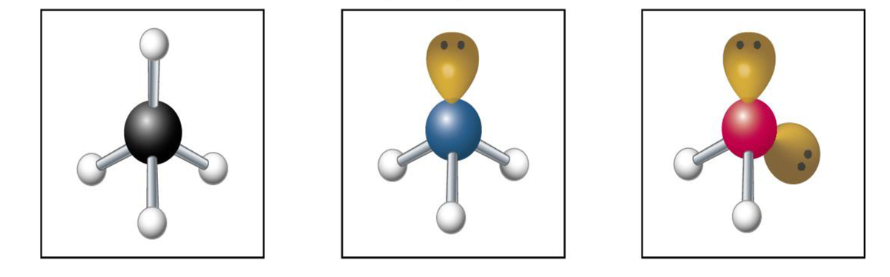
VSEPR
Postulates of VSEPR Theory:
In polyatomic molecules, one of the constituent atoms is identified as the central atom to which all other atoms belonging to the molecule are linked.
The total number of valence shell electron pairs decides the shape of the molecule.
The electron pairs have a tendency to orient themselves in a way that minimizes the electron-electron repulsion between them and maximizes the distance between them. (Lone Pair- lone pair > Lone Pair- bond- pair > Bond Pair- bond pair)
Should the central atom be surrounded by both lone pairs and bond pairs of electrons, the molecule would tend to have a distorted shape.

Slide 4
VSEPR
Limitation
This theory fails to explain isoelectronic species (i.e. elements having the same number of electrons). The species may vary in shapes despite having the same number of electrons.
The VSEPR theory does not shed any light on the compounds of transition metals. The structure of several such compounds cannot be correctly described by this theory. This is because the VSEPR theory does not take into account the associated sizes of the substituent groups and the lone pairs that are inactive.
Another limitation of VSEPR theory is that it predicts that halides of group 2 elements will have a linear structure, whereas their actual structure is a bent one.

Slide 5
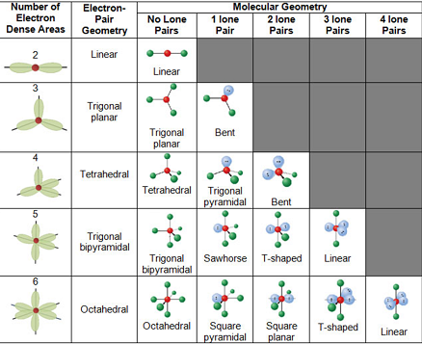
VSEPR
/Shape

Slide 6
Predicting the Shapes of Molecules
The least electronegative atom must be selected as the central atom (since this atom has the highest ability to share its electrons with the other atoms belonging to the molecule).
The total number of electrons belonging to the outermost shell of the central atom must be counted.
The total number of electrons belonging to other atoms and used in bonds with the central atom must be counted.
These two values must be added in order to obtain the valence shell electron pair number or the VSEP number.

Slide 7
Examples
BeF₂, BF₃, CH₄, NH₃, I₃⁻, XeF₄, XeOF₄, SF₄, PO₄³⁻, XeF_{6,} ClF₃

Slide 8
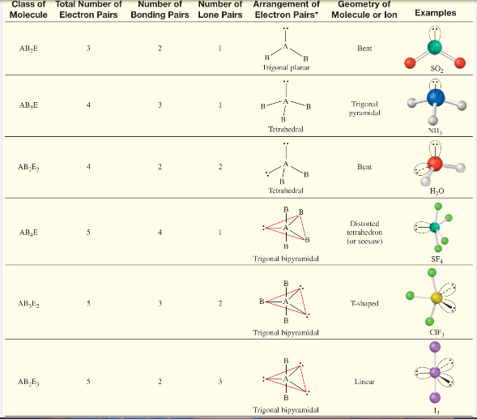
Chemistry for Engineers (CYL 001)
VSEPR Theory

Slide 9
Chemistry for Engineers (CYL 101)
VBT: Valence Bond Theory

Slide 10
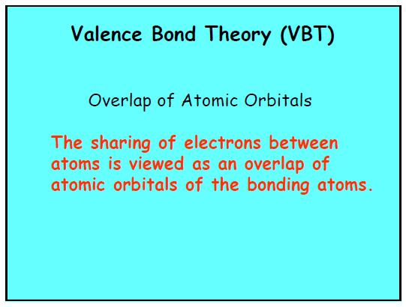

Slide 11
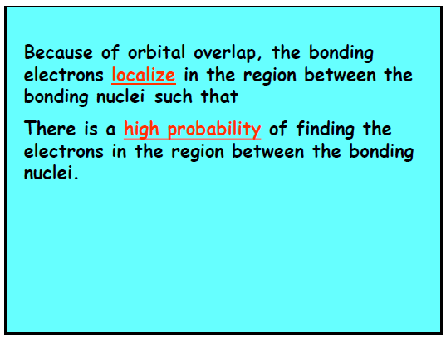

Slide 12
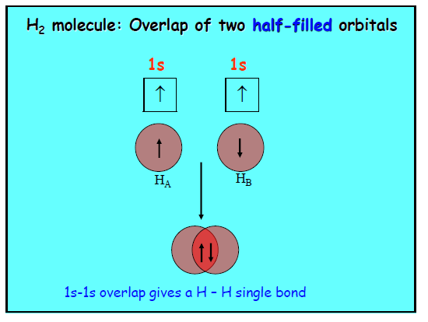

Slide 13
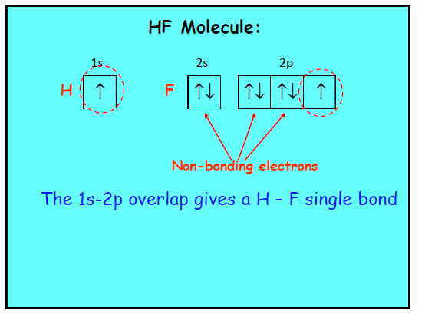

Slide 14
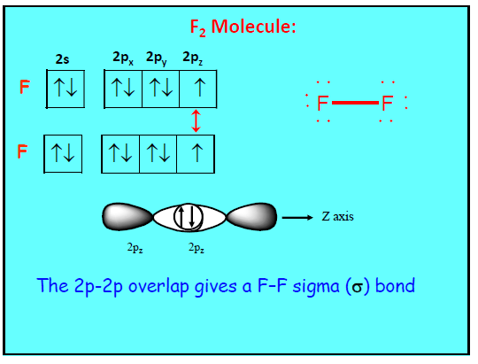

Slide 15
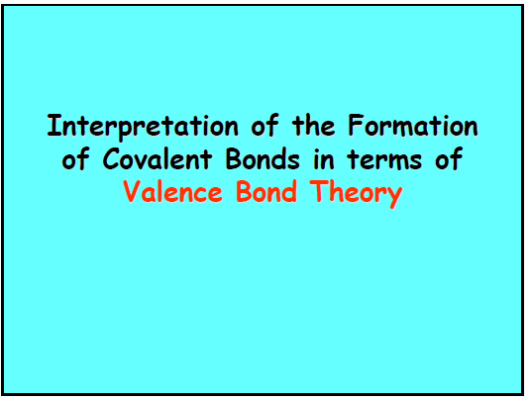

Slide 16
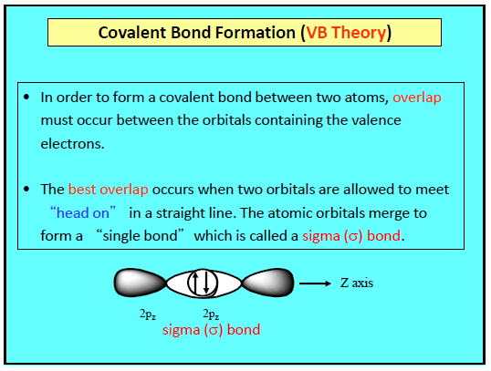

Slide 17
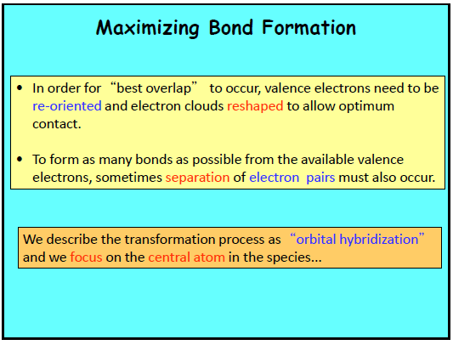

Slide 18
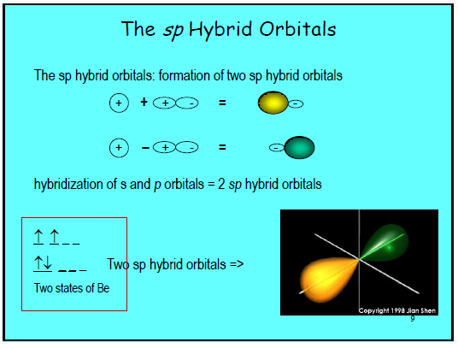

Slide 19
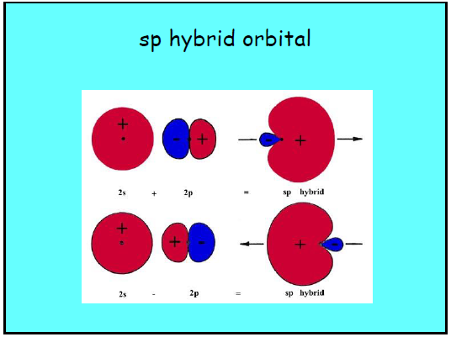

Slide 20
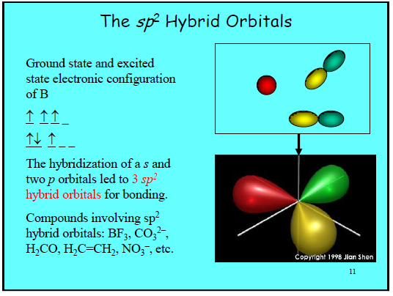

Slide 21
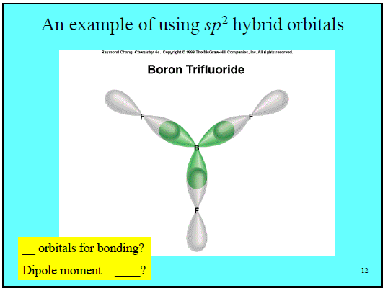

Slide 22
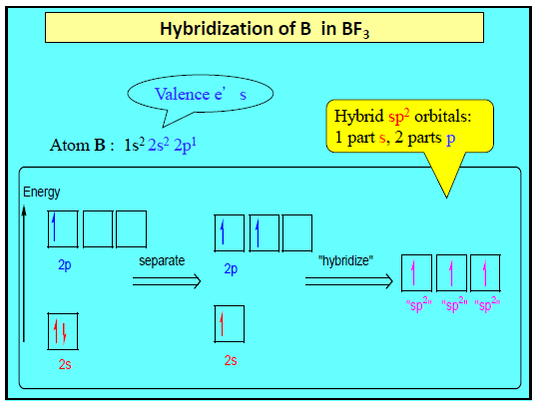

Slide 23
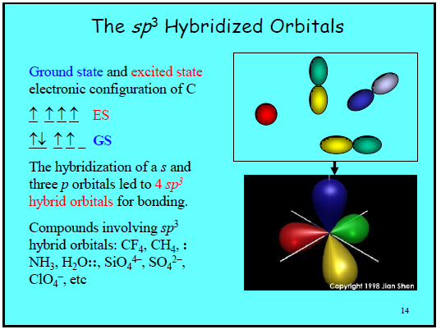

Slide 24
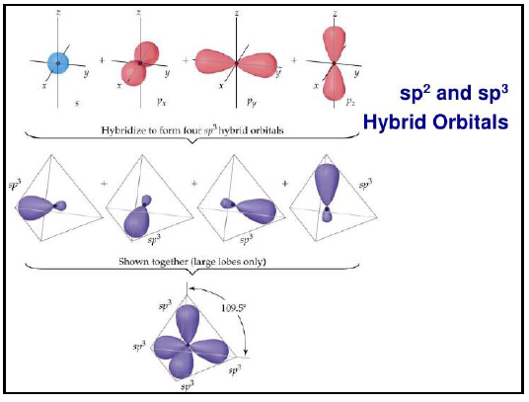

Slide 25
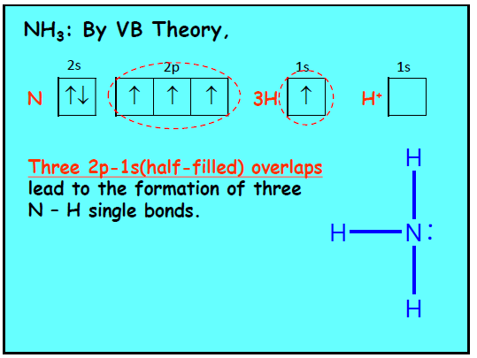

Slide 26
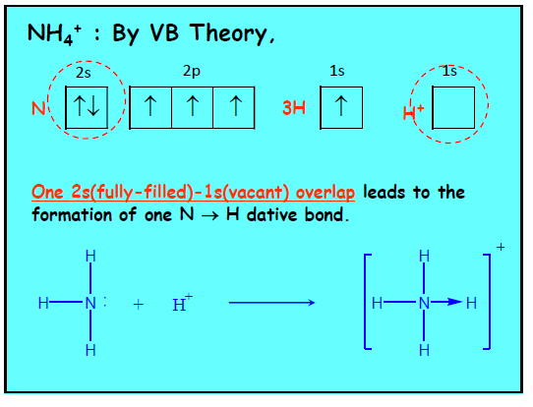

Slide 27
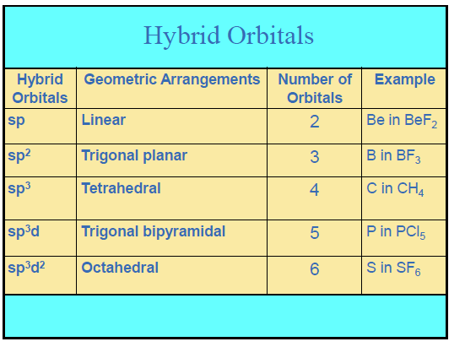

Slide 28
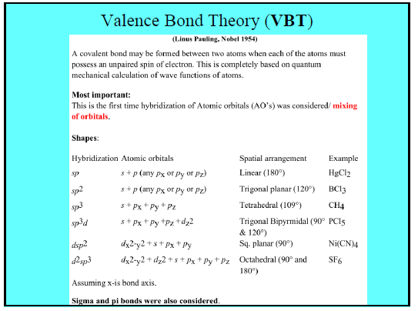

Slide 29
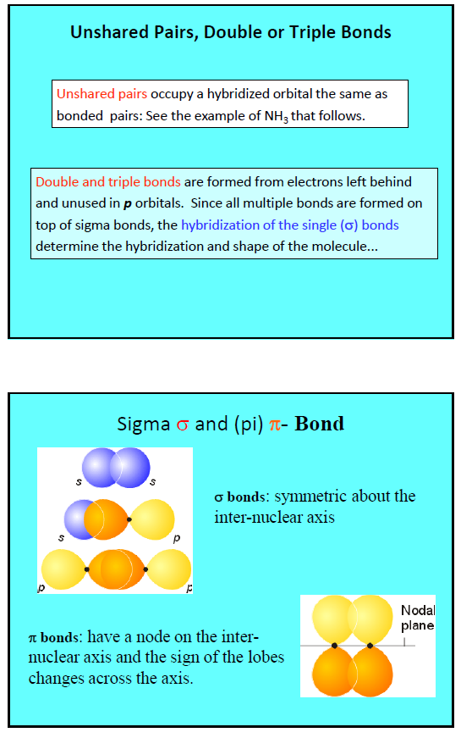

Slide 31
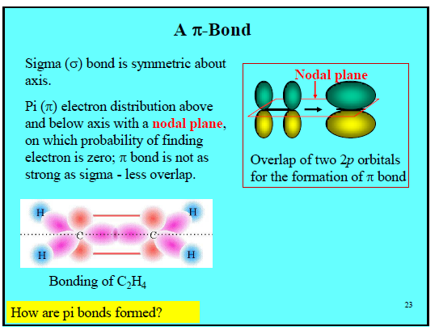

Slide 32
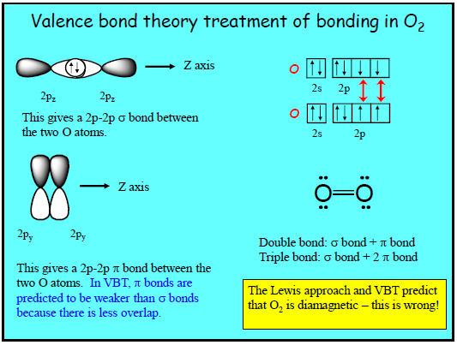

Slide 33
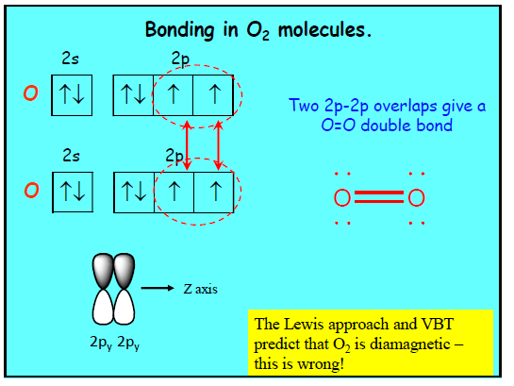

Slide 34
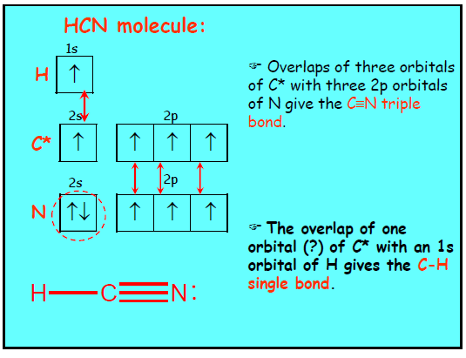

Slide 35
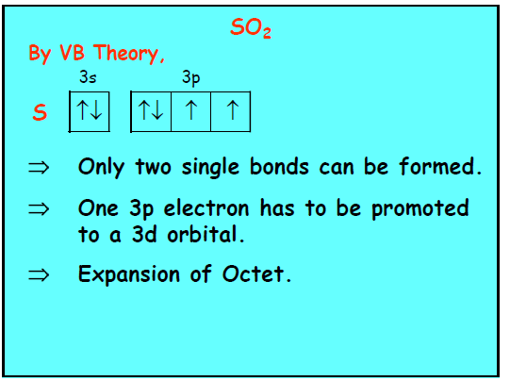

Slide 36
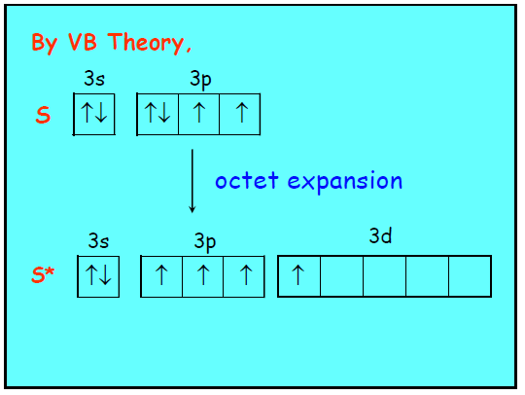

Slide 37
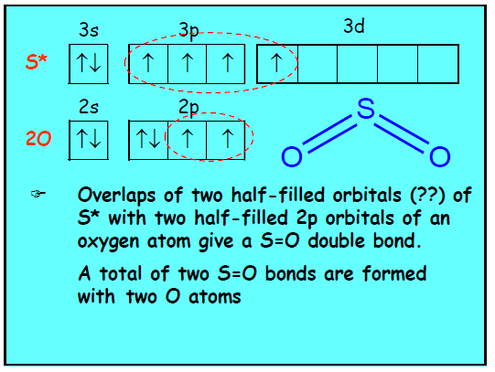

Slide 38
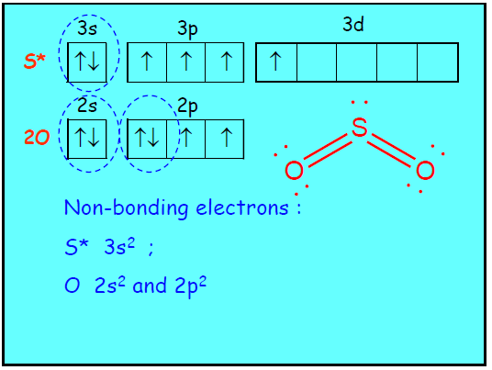

Slide 39
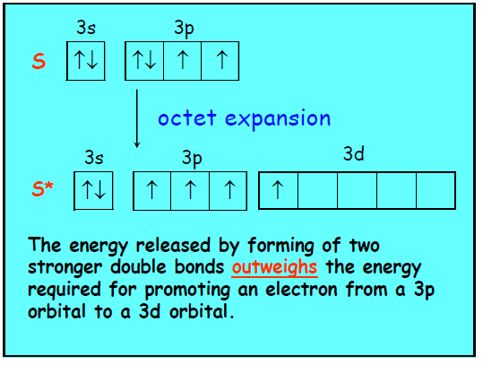

Slide 40
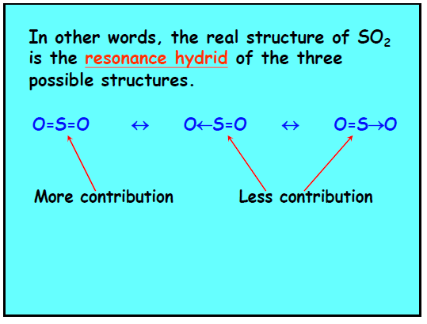

Slide 41
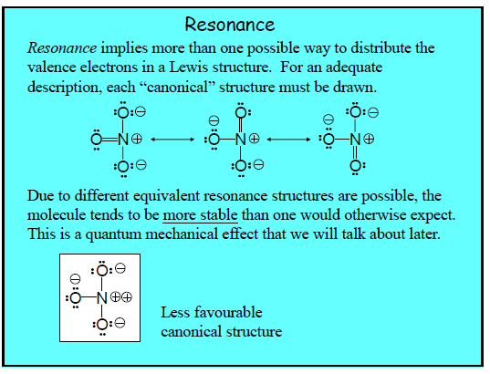

Slide 42
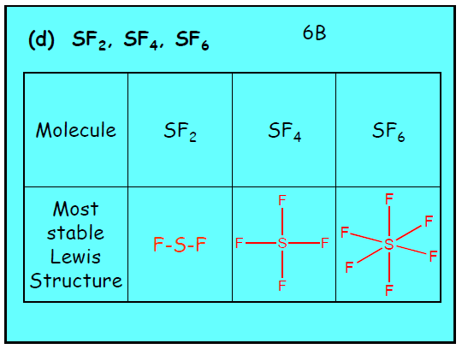

Slide 43
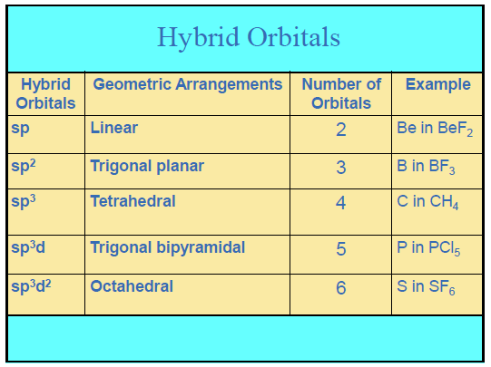

Slide 44
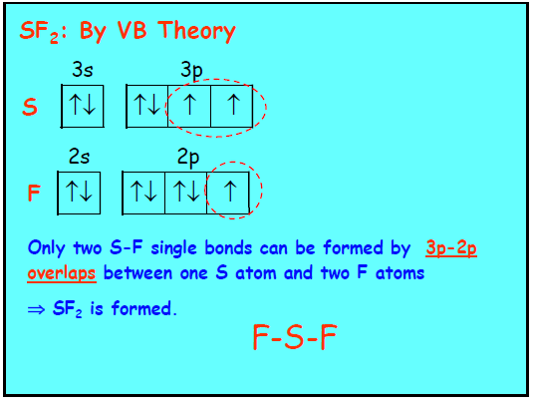

Slide 45
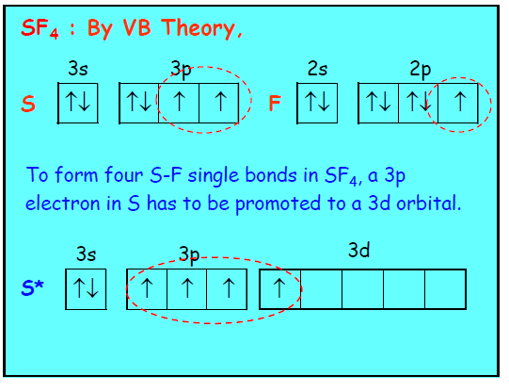

Slide 46
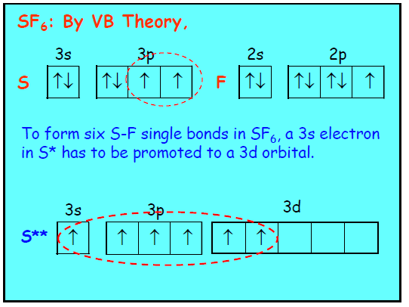

Slide 47
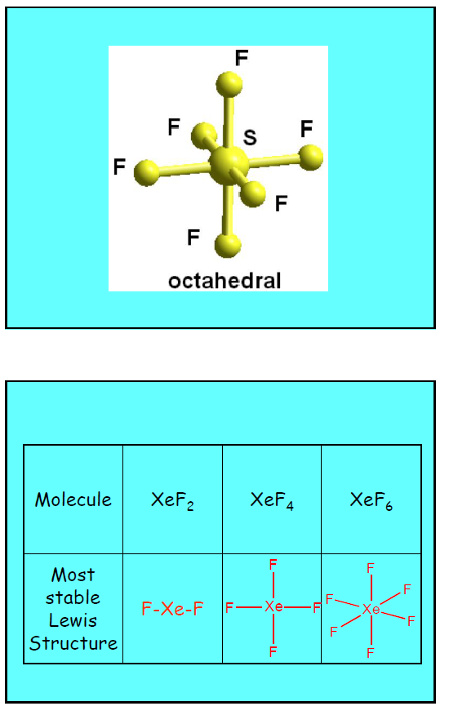

Slide 48
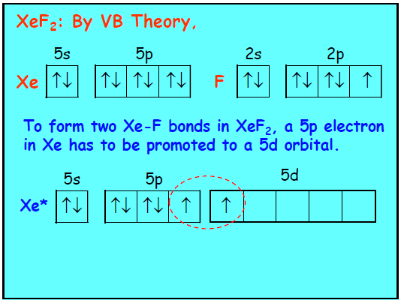

Slide 49
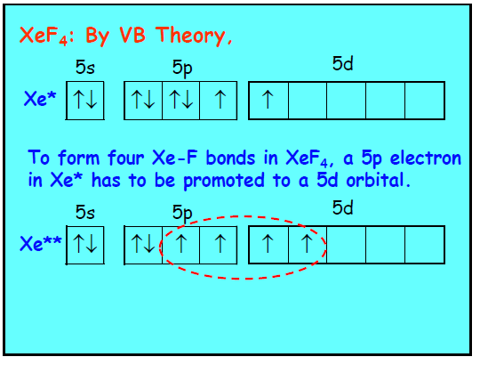

Slide 50
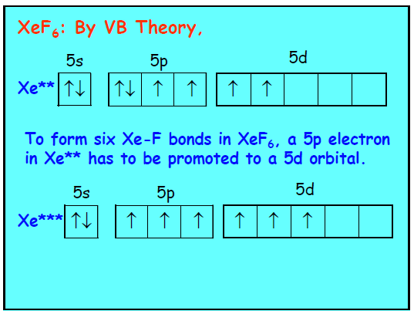
XeOF₄

Slide 51
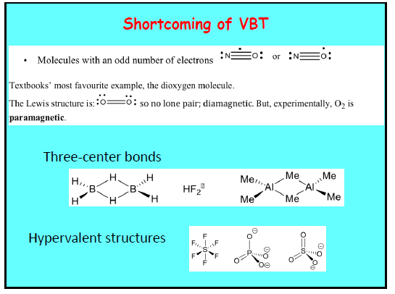

Slide 52
Shortcoming of VBT
Larger molecules become complicated
Solely depends on spin pairing for bond formation: What about the lone pair of dioxygen molecules.
Odd electron species like H₂⁺, He₂⁺ can’t explain
Bonding between metals can’t explain.
Explain about only Positive overlap of atomic orbitals; what about negative overlap which results antibonding.

Slide 53
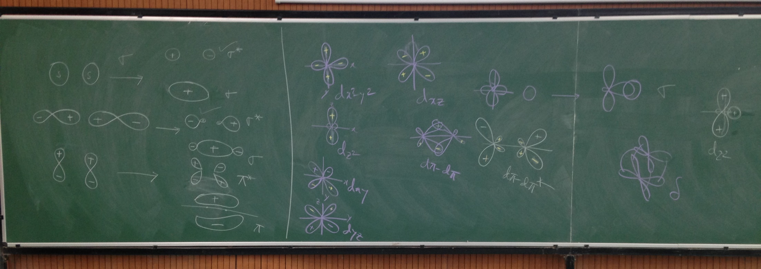
Class Board work regarding the Bonding Orbital
nb

